Slide 1
Optimizing Muscle Activations for Cycling
24-785 Project Proposal
Mikayla Schneider
Risheekesh Kesavan
Pratiksha Ganesan
Ravesh Sukhnandan

Slide 2
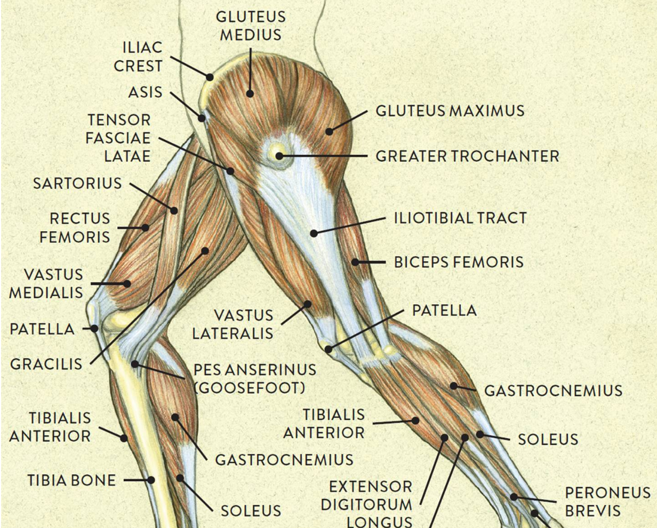
The human body has more muscles than it does degrees-of-freedom (DOF)
Knee joint: 1 DOF
Modelling and Simulation of human biomechanics
Each joint in the human body has a number of kinematic degrees of freedom, and each action can be performed in different ways using different combinations of muscles to achieve the same joint torque needed for this movement.
Experimental studies have found significant similarity in these muscle activation patterns for different individuals.
Modelled simulations can be applied to predict changes of kinematics and muscle response to interventions or environmental changes. They can support decisions in orthopaedic surgery.
Physical therapy/orthopaedic surgery
Optimizing sports performance
Robotics
How does the body decide which muscle(s) to activate to perform a given task?
[1] “Muscles of the Leg and Foot - Classic Human Anatomy in Motion: The Artist’s Guide to the Dynamics of Figure Drawing.” https://doctorlib.info/anatomy/classic-human-anatomy-motion/8.html
Notes:
Each joint in the human body has a number of kinematic degrees of freedom, and each action can be performed in different ways using different combinations of muscles to achieve the same joint torque needed for this movement.
Experimental studies have found significant similarity in these muscle activation patterns for different individuals.
Modelled simulations can be applied to predict changes of kinematics and muscle response to interventions or environmental changes. They can support decisions in orthopaedic surgery.

Slide 3
Pedalling a bicycle is a 2D problem that exhibits muscle redundancy
Problem Statement:
We aim to optimize the lower limb muscle activations during cycling by using joint kinematics and kinetics from literature, and compare to previously gathered EMG data.
[1] Which Muscles Are Used When Riding a Bike?, (Mar. 30, 2017). [Online Video]. Available: https://www.youtube.com/watch?v=MqLHuwxB5-c

Slide 4
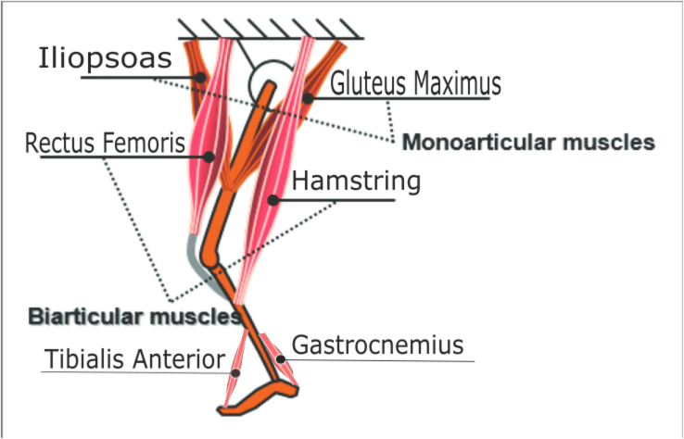
Model
Governed by:
∑F - ∑F_{a} = m*a - ∑F_{a}= 0
Given F_{a} (applied pedal force) and joint positions
Lee C, Oh S. “Development, Analysis, and Control of Series Elastic Actuator-Driven Robot Leg”. Front Neurorobot. 2019 May 7;13:17. doi: 10.3389/fnbot.2019.00017.
Notes:
Our model is a 2-D system of the leg as shown. It consists of 3 rigid segments (thigh, shank, and foot) and has 3 joints (hip, knee, and ankle) each with one degree of freedom. The leg is actuated by 6 muscles as shown. Some are monoarticular (glutes, iliopsoas, tib ant and gastroc) and the last two are biarticular, so they can affect two joints.

Slide 5
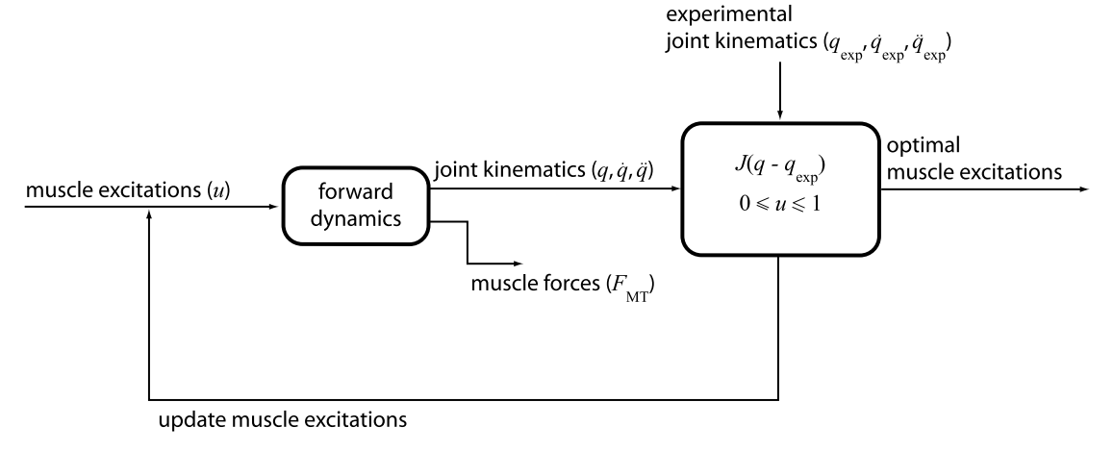
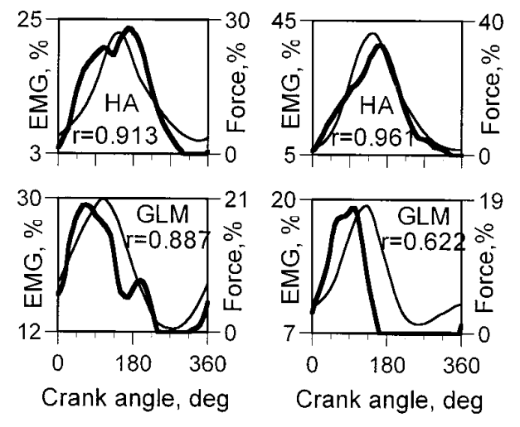
Forward dynamics approach uses measured joint kinematics to produce optimal muscle excitations
Measured EMG of Muscle (HA = Hamstring, GLM = Glutes) [2]
Forward Dynamics [1]
[1] A. Erdemir, S. McLean, W. Herzog, and A. J. van den Bogert, “Model-based estimation of muscle forces exerted during movements,” Clinical Biomechanics, vol. 22, no. 2, pp. 131–154, Feb. 2007, doi: 10.1016/j.clinbiomech.2006.09.005.
[2] B. I. Prilutsky and R. J. Gregor, “Analysis of muscle coordination strategies in cycling,” IEEE Transactions on Rehabilitation Engineering, vol. 8, no. 3, pp. 362–370, Sep. 2000, doi: 10.1109/86.867878.

Slide 6
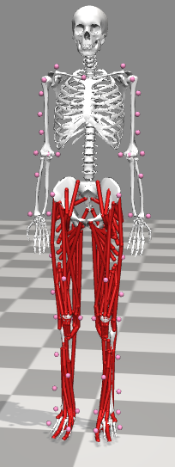
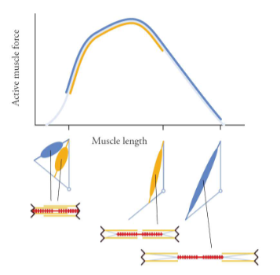
Methodology/Tools
Natural constraints and sub-optimization problems arise from the physiological properties of our muscles, such as the force-length-moment arm relationship [2]
← OpenSim [1]
Open-source software with ability to easily run forwards dynamics for validation
[1] Delp SL, Anderson FC, Arnold AS, Loan P, Habib A, John CT, et al. OpenSim: Open source to create and analyze dynamic simulations of movement. IEEE Trans Biomed Eng. 2007;54(11):1940–50.
[2] Uchida, Thomas and Delp, Scott. “Biomechanics of Movement: The Science of Sports, Robotics, and Rehabilitation.” MIT Press, 2020

Slide 7
Planned Schedule
Oct 26th | Project Proposal Reports
Week of 7th November | Model working for cycling using assumed kinematics
Week of 21st November | Pipeline for testing optimization approach (output of EMG from optimizer to compare against literature)
Nov 24th | Thanksgiving
Week of Nov 28th | Fine tuning model. Stretch goal: collect experimental data to get full kinematics + EMG + kinetics data.
Week of Dec 5th | Finalizing presentation and report
Dec 6th - 8th | Final Project Presentations

Slide 8
References
Video on 1st slide: https://www.youtube.com/watch?v=8SqfJwcwSD8&ab_channel=ActivateSportsClub

Slide 9
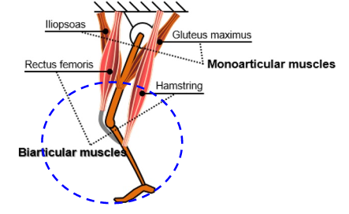
Problem Statement
Locomotion is a fundamental task for all human beings.
We aim to optimize the lower limb muscle action in the human body during physical activities like cycling, using joint kinematics to model the physical exertion and compare against known literature data to build optimized models.

Slide 10
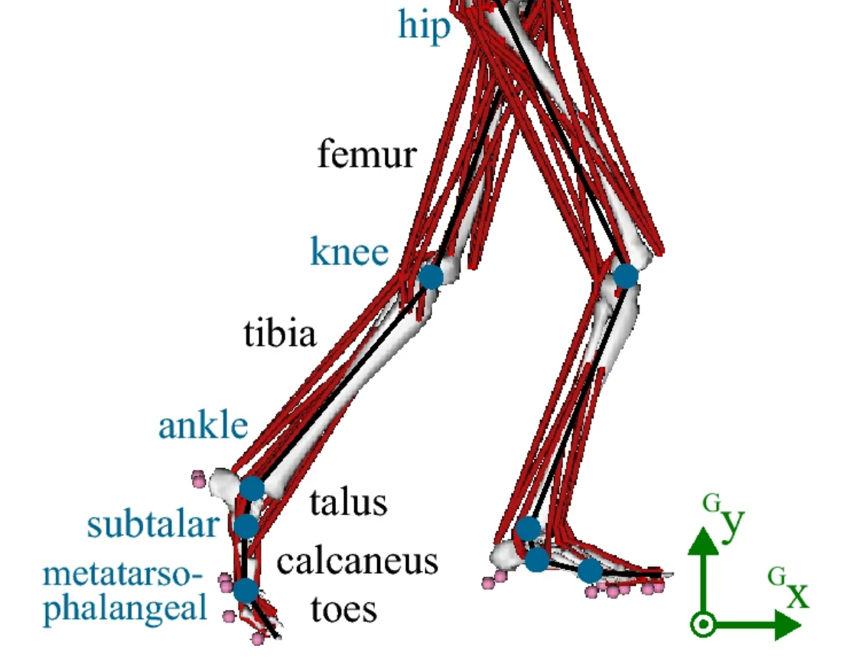
Introduction:
Each joint in the human body has a number of kinematic degrees of freedom, and each action can be performed in different ways using different combinations of muscles to achieve the same joint torque needed for this movement.
Experimental studies have found significant similarity in these muscle activation patterns for different individuals.
Modelled simulations can be applied to predict changes of kinematics and muscle response to interventions or environmental changes. They can support decisions in orthopaedic surgery.

